Slide 1

Pneumonia Detection Using CNN
AI Mini Project
Team Members -
Dhruv Bajaj RA1911032010054
Shubham Patil RA1911032010045
Harshal Gupta RA1911032010035

Slide 2
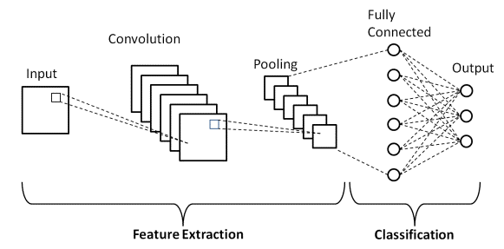
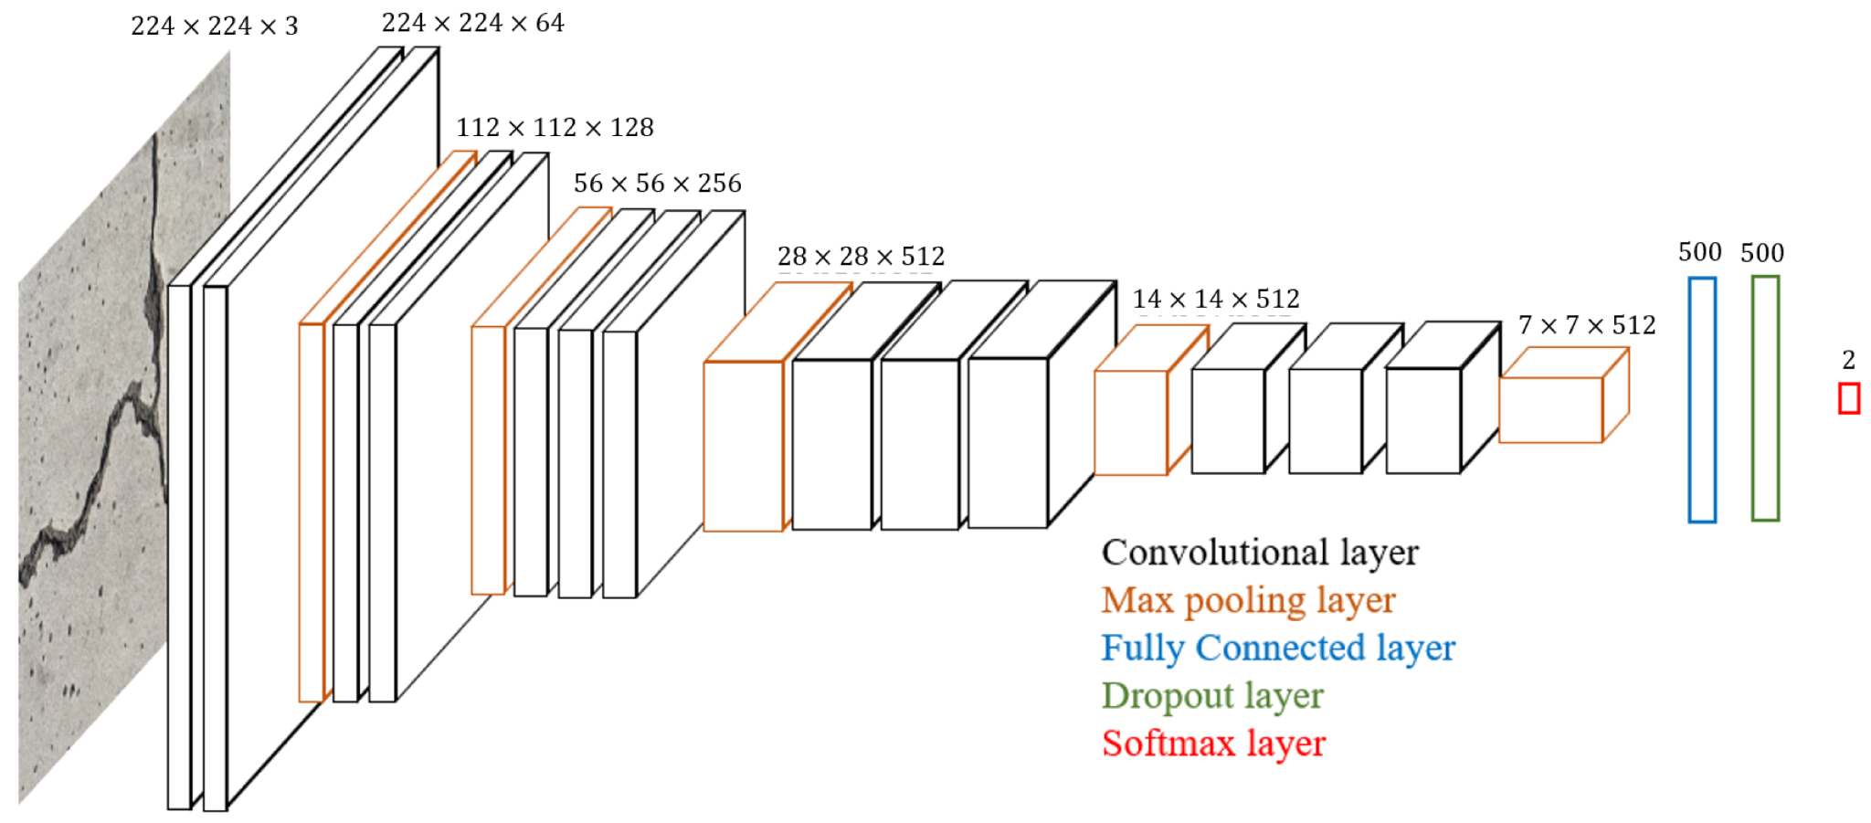
Objectives
Technique
Process Diagram
Societal Benefits
Importance
A computer-aided diagnosis system for automatic pneumonia detection using chest X-ray images has been developed in this project. Deep transfer learning has been employed to handle the scarcity of available data.
With 90% precision, the model is trained in such a way that it detects pneumonia with the help of chest X-ray images wherein, the dataset used is this from Kaggle.
Hence, to address this problem and aid the detection of this severe disease, our team has created a pneumonia detection model using deep learning (CNN)
1. Image data gen basically used for rescaling, sizing, turning into images fit for neural networks.
2. The model has used VGG19 which is an object-recognition model that supports up to 19 layers of cnn for image classification.
3. Then we used Residual Network (ResNet) which is a Convolutional Neural Network (CNN) architecture that overcame the “vanishing gradient” problem, It has predefined weights which helps us in image classification
4. Resnet is the best model over this dataset with proper hypertuning of parameters
5. Speech API is used for voice-over output.
6. PyQt file is imported for graphic widgets and interface to connect our backend model
Convolution Neural Network Architecture
Pneumonia has caused significant deaths worldwide.
It is a challenging task to detect many lung diseases such as like atelectasis, cardiomegaly, lung cancer, etc., often due to limited professional radiologists in hospital settings.
With this model, we can track pneumonia in its’ initial stages and may lead to an increase in the survival rate of lung patients.
Early detection of pneumonia disease can increase the survival rate of lung patients.
Chest X-ray (CXR) images are the primarily means of detecting and diagnosing pneumonia.
Detecting pneumonia from CXR images by a trained radiologist is a challenging task.

Slide 3
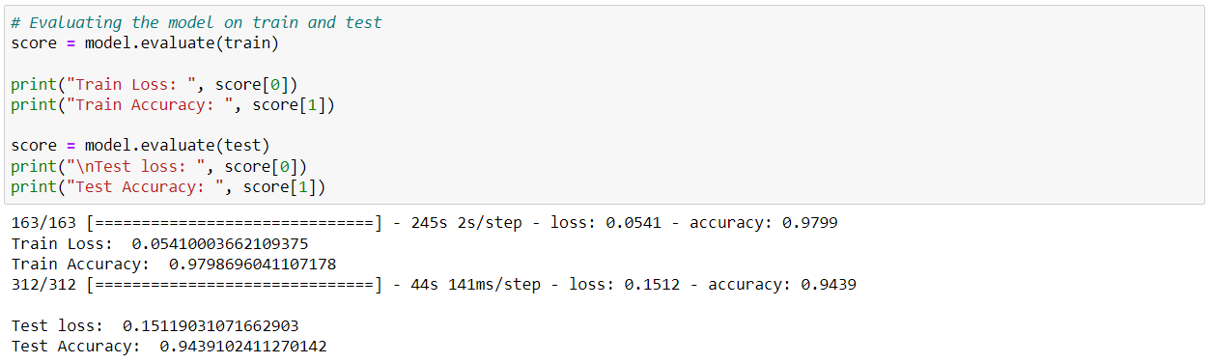
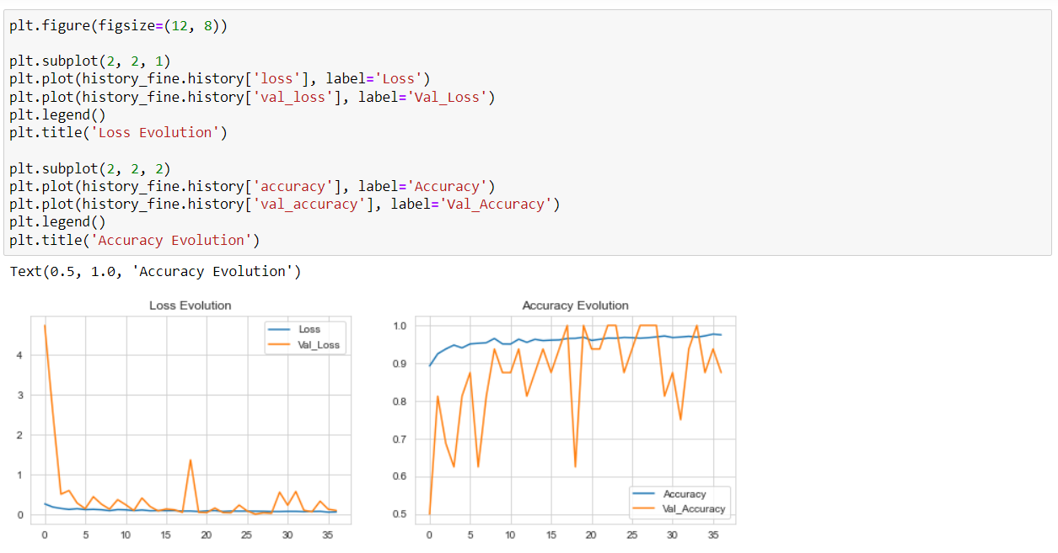
Results
Graphs
Suggested Future Enhancements
Inferences
The accuracy of the model can be increased by rescaling, resizing, repurposing of the chest x-ray images for a clearer image quality for the neural network to process
After training the model over a Convolutional Neural Network as well as a Recurrent Neural Network, the model turns out to perform with a better accuracy through a CNN rather than a RNN, hence it has been used as the primary neural network for this model.
The CNN model has been successfully able to classify x-ray images into pneumonic and normal lungs.

Slide 4
THANK YOU!

